Slide 1
Green Village Manager

Slide 2
agenda
INTRODUCTION
Usability Testing
Heuristic Evaluation
Recommendation
Prototype

Slide 3

Greater Aghor Village Application Includes some services. •Latest village news. •Create an account and add data. •The doctors. •Communications. •Libraries. •Technical. •Teachers and pharmacies. The application saves time and effort to search for places and times of institutions located in the village and a way to communicate with all members of the village to share their daily conditions as a social communication application.
INTRODUCTION

Slide 4
Task (1) log in
Task (2) log out.
Task (3) create account.
Task (4) view favorites
Task (5) app appearance mode
Task (6) Add post.
Task (7) view post
Task (8) like post
Task (9) comment in post
Task (10) share, copy post.
Task (11) search category
Task (12) view notification
Task (13) choose category.
Task (14) add element in category.

Slide 5
Criteria | Excellent | Acceptable | Unacceptable
Task (1) log in
Number of clicks | 6 | 7 | 11
Number of wrong clicks | 0 | 1 | 5
Task (2) log out
Number of clicks | 3 | 4 | 7
Number of wrong clicks | 0 | 1 | 4
Task (3) create account
Number of clicks | 7 | 8 | 10
Number of wrong clicks | 0 | 1 | 3
Task (4) view favorites
Number of clicks | 1 | 2 | 3
Number of wrong clicks | 0 | 1 | 2
Task (5) app appearance mode
Number of clicks | 3 | 4 | 6
Number of wrong clicks | 0 | 1 | 3
Task (6) Add post
Number of clicks | 4 | 5 | 8
Number of wrong clicks | 0 | 1 | 4
Task (7) view post
Number of clicks | 1 | 2 | 3
Number of wrong clicks | 0 | 1 | 2
Task (8) like post
Number of clicks | 2 | 3 | 4
Number of wrong clicks | 0 | 1 | 2
Task (9) comment in post
Number of clicks | 4 | 5 | 7
Number of wrong clicks | 0 | 1 | 3
Task (10) share, copy post
Number of clicks | 2 | 3 | 4
Number of wrong clicks | 0 | 1 | 2
Task (11) search category
Number of clicks | 1 | 2 | 4
Number of wrong clicks | 0 | 1 | 3
Task (12) view notification
Number of clicks | 1 | 2 | 3
Number of wrong clicks | 0 | 1 | 2
Task (13) choose category
Number of clicks | 1 | 2 | 3
Number of wrong clicks | 0 | 1 | 2
Task (14) add element in category
Number of clicks | 8 | 9 | 12
Number of wrong clicks | 0 | 1 | 4

Slide 6
Results Of Usability Testing (Aghour El-Kobra’s category):
task | U1 | U2 | U3 | U4 | U5 | U6 | U7 | U8 | U9 | U10 | U11 | U12 | U13 | total | avg | performance
1 | 7 | 7 | 6 | 7 | 7 | 8 | 9 | 7 | 7 | 7 | 7 | 7 | 7 | 93 | 7 | Acceptable
2 | 3 | 3 | 3 | 3 | 3 | 3 | 3 | 3 | 3 | 3 | 3 | 3 | 3 | 39 | 3 | excellent
3 | 7 | 8 | 9 | 7 | 7 | 9 | 8 | 8 | 8 | 8 | 7 | 8 | 8 | 102 | 8 | Acceptable
4 | 1 | 1 | 1 | 1 | 1 | 1 | 1 | 1 | 1 | 1 | 1 | 1 | 1 | 13 | 1 | excellent
5 | 3 | 3 | 3 | 3 | 3 | 3 | 3 | 3 | 4 | 3 | 3 | 3 | 3 | 40 | 3 | excellent
6 | 5 | 4 | 4 | 5 | 5 | 4 | 4 | 5 | 5 | 5 | 4 | 5 | 5 | 60 | 5 | excellent
7 | 1 | 1 | 1 | 1 | 1 | 1 | 1 | 1 | 1 | 1 | 1 | 1 | 1 | 13 | 1 | excellent
8 | 2 | 2 | 3 | 2 | 2 | 2 | 2 | 2 | 2 | 2 | 2 | 2 | 2 | 27 | 2 | excellent
9 | 4 | 4 | 3 | 4 | 4 | 4 | 4 | 4 | 4 | 4 | 4 | 4 | 4 | 51 | 4 | excellent
10 | 2 | 2 | 2 | 3 | 2 | 2 | 2 | 2 | 2 | 2 | 2 | 2 | 2 | 27 | 2 | excellent
11 | 1 | 1 | 1 | 1 | 1 | 1 | 1 | 1 | 1 | 1 | 1 | 1 | 1 | 13 | 1 | excellent
12 | 1 | 2 | 2 | 2 | 2 | 2 | 1 | 2 | 1 | 1 | 2 | 3 | 1 | 22 | 2 | acceptable
13 | 1 | 1 | 2 | 2 | 2 | 2 | 1 | 2 | 1 | 2 | 1 | 2 | 1 | 20 | 2 | acceptable
14 | 8 | 9 | 10 | 11 | 10 | 9 | 11 | 10 | 9 | 8 | 10 | 11 | 10 | 126 | 10 | acceptable

Slide 7
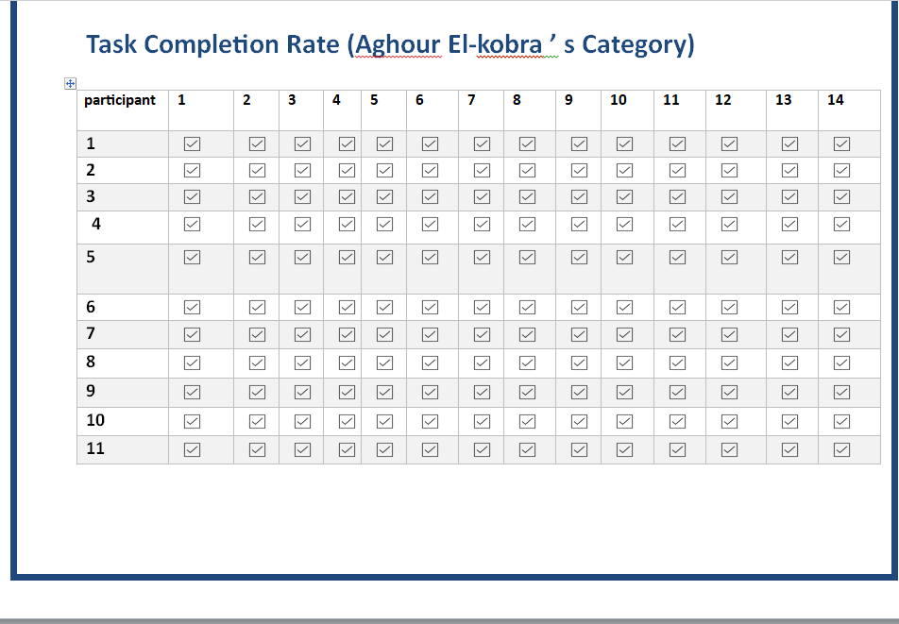
Task Completion Rate (Aghour El-kobra ’ s Category)

Slide 8
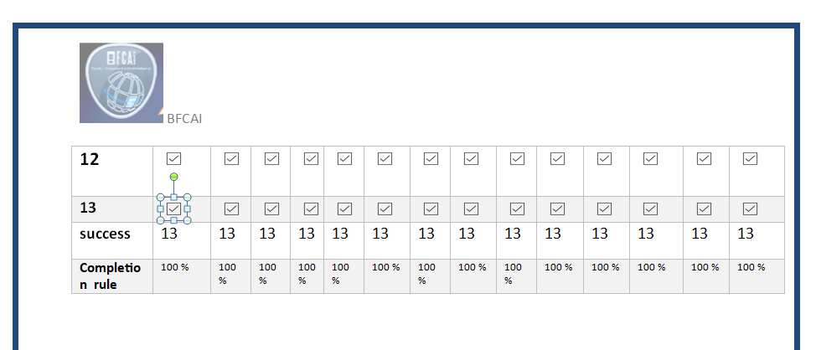

Slide 9
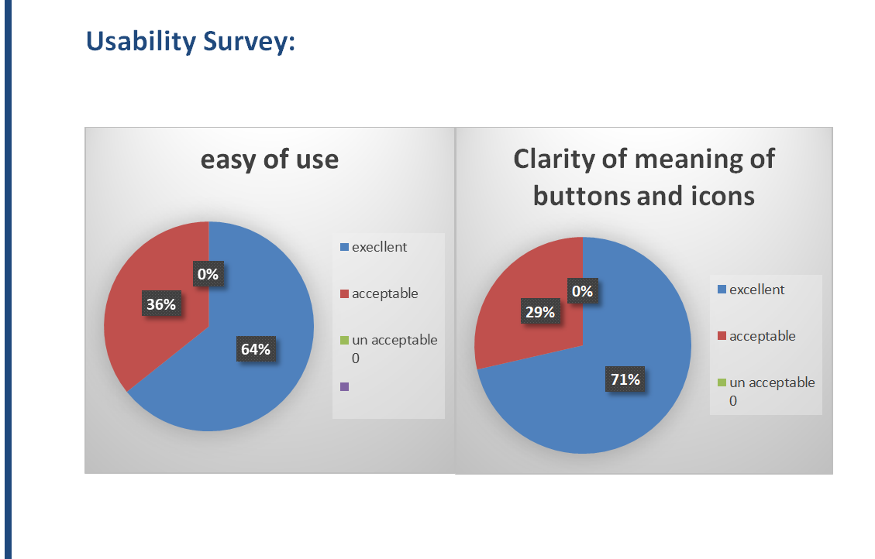

Slide 10
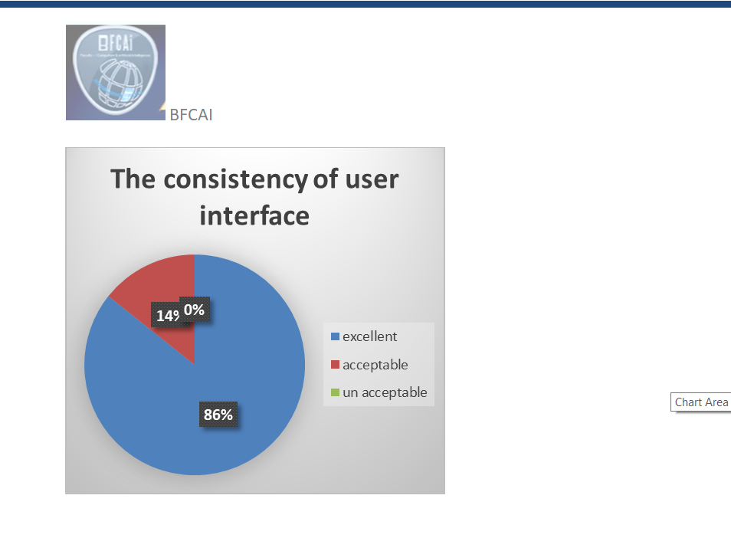

Slide 11


The Eight Golden Rules of Interface Design
Rule | Question considers | Mark
Strive for consistency | Icons consistency in home page and other pages and same design
Seek universal usability | Not in system
Offer informative feedback. | If add profile photo it sends messages that its updated. if send post it sends message that admin will approve it.
design dialogs to yield closure | When user want to log out app make sure he wants it.
Prevent errors | If user entered password less than 8 character it. give message to help him
Permit easy reversal of actions. | If user want to cancel create post or not log out from system
Keep users in control | If user want to كcontrol adding post or change appearance of the app.
Reduce short-term memory load | If user want to move between the categories and not have to remember much info.

Slide 12
Nielsen's 10 Usability Heuristics:
Heuristic | Question considers | Mark
Visibility of system status | No
Match between system and the real world | Icons of pages like real world
User control and freedom | Navigate easily between pages with back arrows.
Consistency and standards: | Icons consistency in home page and other pages and same design
Prevent errors | If user entered password less than 8 character it. give message to help him
Recognition rather than recall | No
Flexibility and efficiency of use | No
Aesthetic and minimalist design | Design is simple and recognized easily and clear.
Help users recognize, diagnose, and recover from errors | Error messages to help user to add. Password instructions.
Help and documentation | No

Slide 13
.Recommendation to solve in tasks
Task | Problem | Recommendation
Task (1) | User faces some difficulties uses this task. | Simplify UI to be more specific not conflicting with other processes.
Task (3) | User faces some difficulties uses this task. | Simplify UI to be more specific not conflicting with other processes.
Task (12) | Not under user control | Make users control notification as they want
Task (13) | Accessibility issues | Make elements more flexible and clearer to users
Task (14) | Too many steps for users | Undo actions to make it simpler

Slide 14


Slide 15
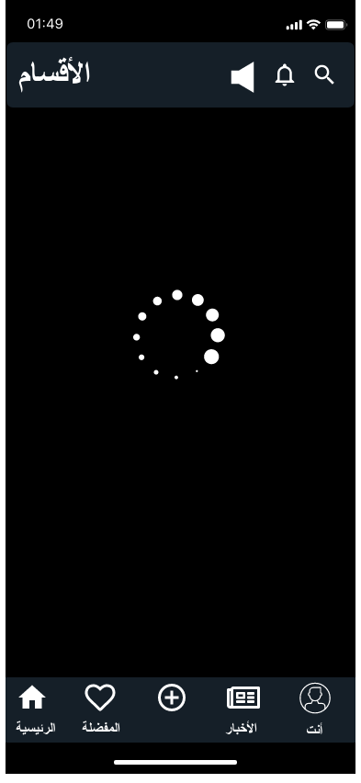

Slide 16
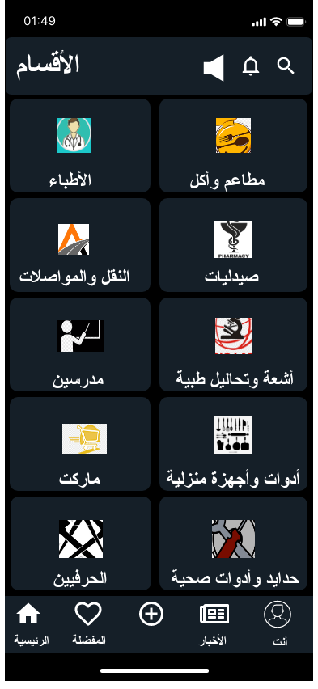

Slide 17
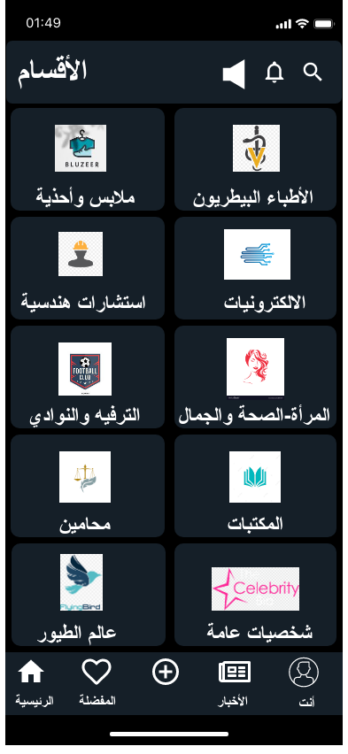

Slide 18
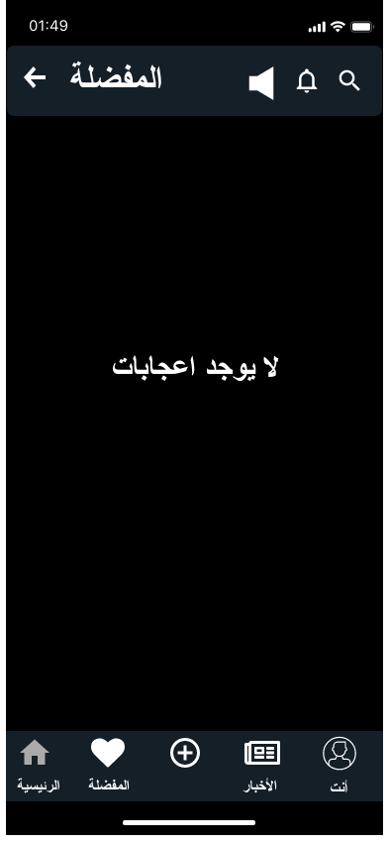

Slide 19
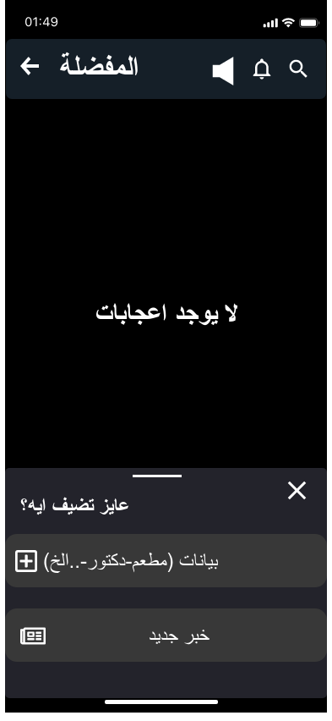

Slide 20
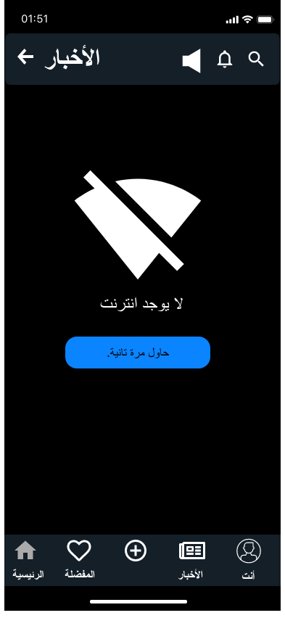

Slide 21
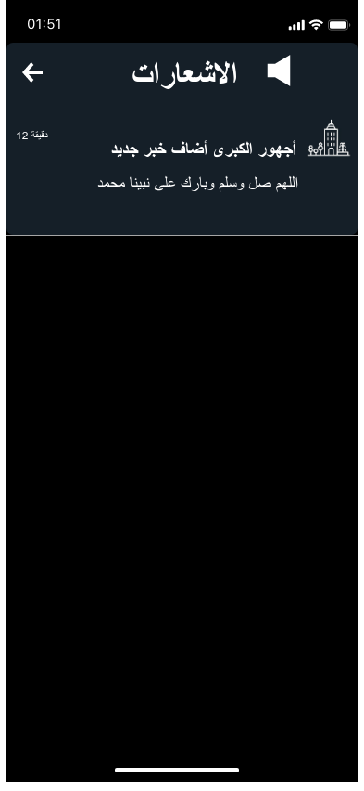

Slide 22
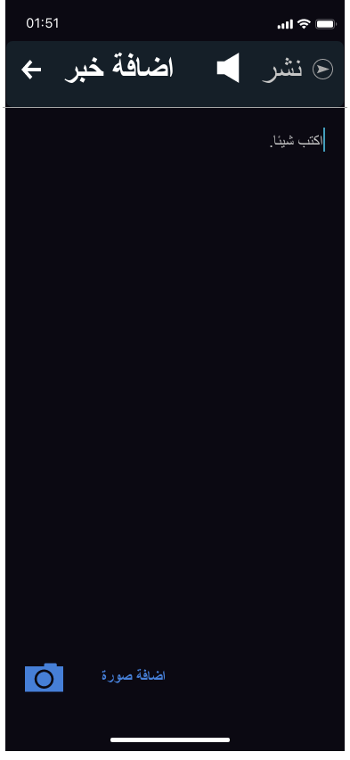

Slide 23
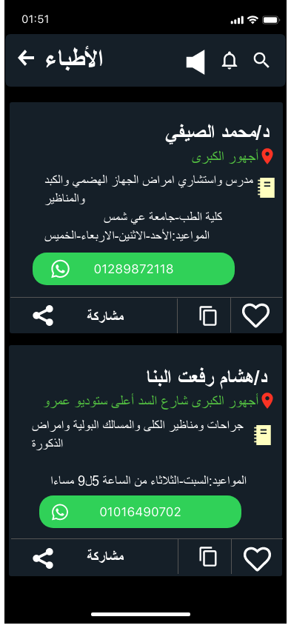

Slide 24
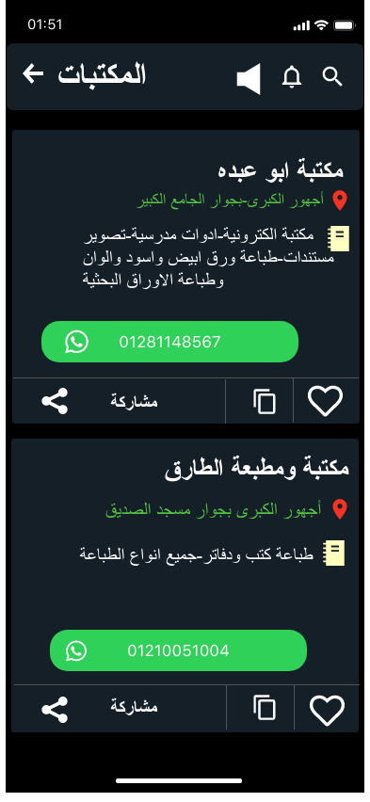

Slide 25
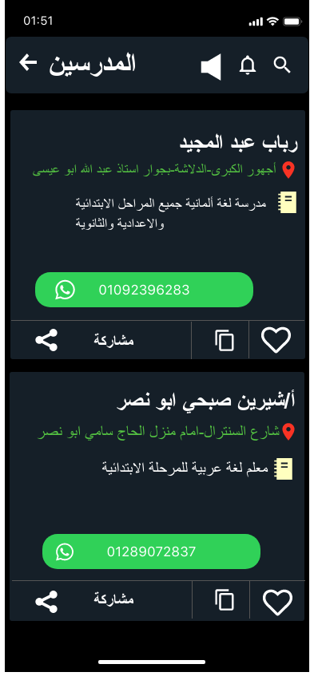

Slide 26
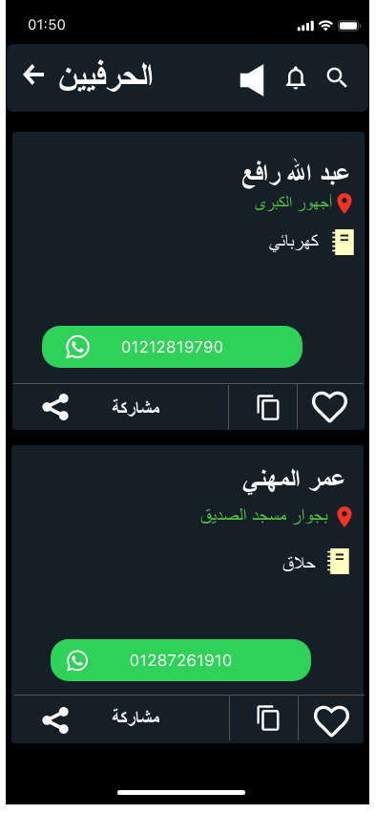

Slide 27
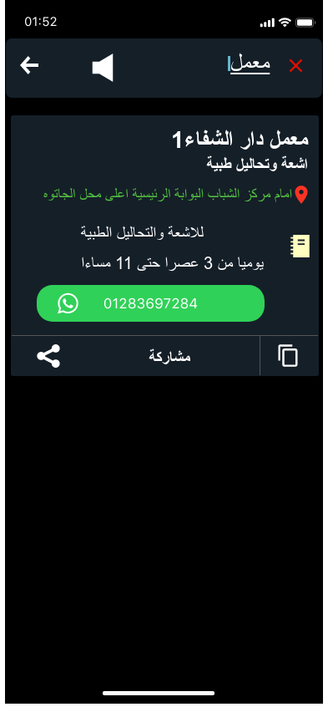

Slide 28
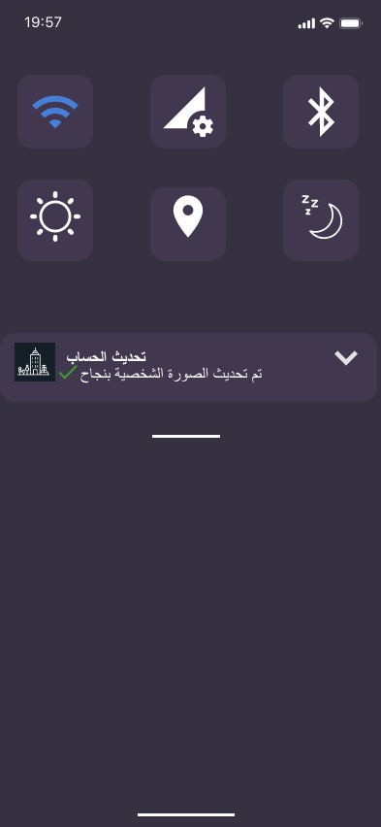

Slide 29
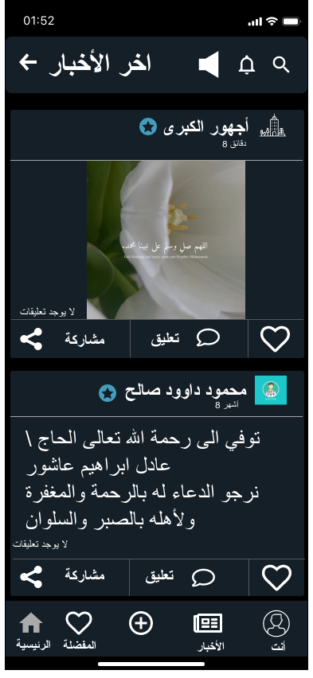

Slide 30
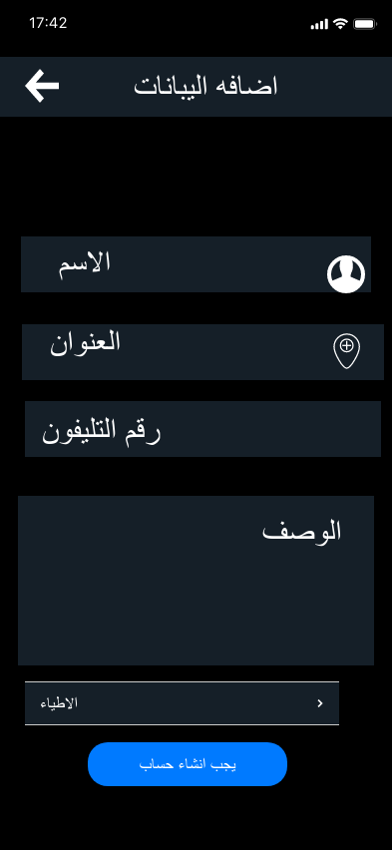

Slide 31
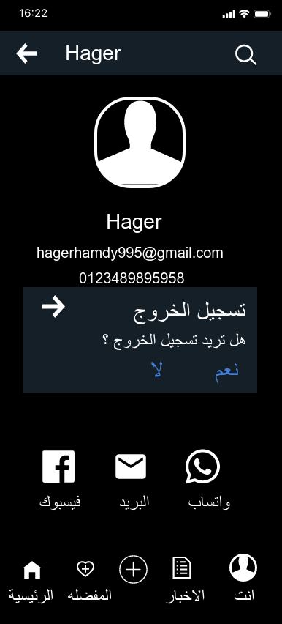

Slide 32
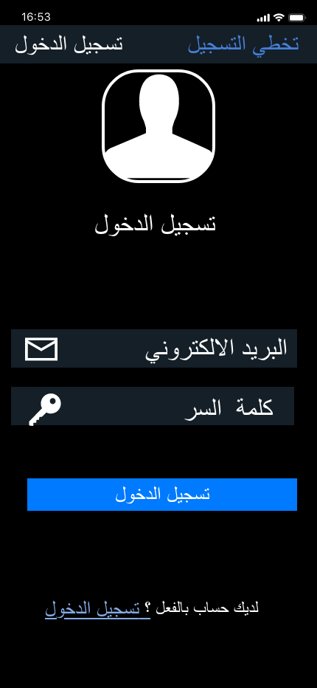

Slide 33
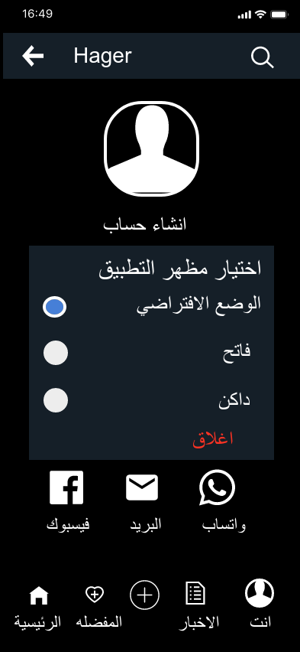

Slide 34
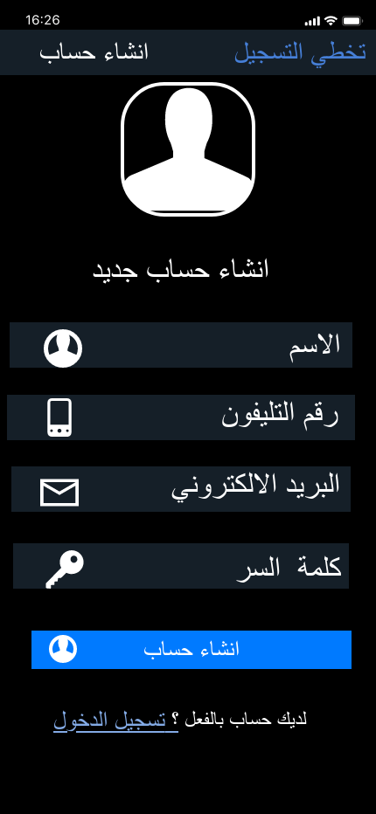

Slide 35
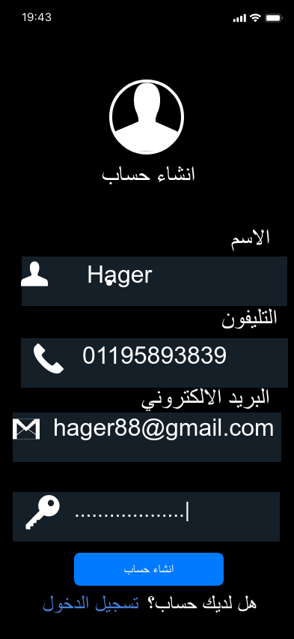

Slide 36
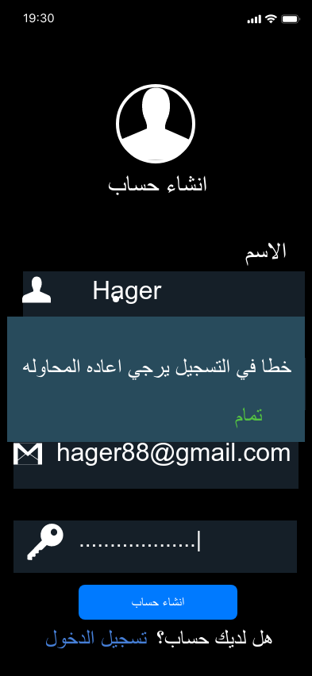

Slide 37
